Slide 1
CIM workshop
Richard Siddaway

Slide 2
Celebrating 10 Years of PowerShell 2006 - 2016
Jeffrey Snover
Kenneth Hansen
Lee Holmes
Narayanan Lakshmanan
Hemant Mahawar
Bruce Payette
Hitesh Raigandhi
Dan Travison
Jim Truher
Krishna Vutukuri
Congratulations to the team members who’ve been there since the beginning…
...and thanks for all the great work!

Slide 3
Agenda
Discovery
Structure of CIM and finding classes
Associations and References
WMI accelerators
CIM cmdlets
WQL
CIM sessions
CDXML
CIMservice module
Issues and ‘Gotchas’
CIM events

Slide 4
DISCOVERY

Slide 5
CIM = WMI = CIM
WMI is Microsoft’s first implementation of CIM
CIM (in PowerShell) refers to second implementation using new API which also is more standards compliant

Slide 6
CIM structure

Slide 7
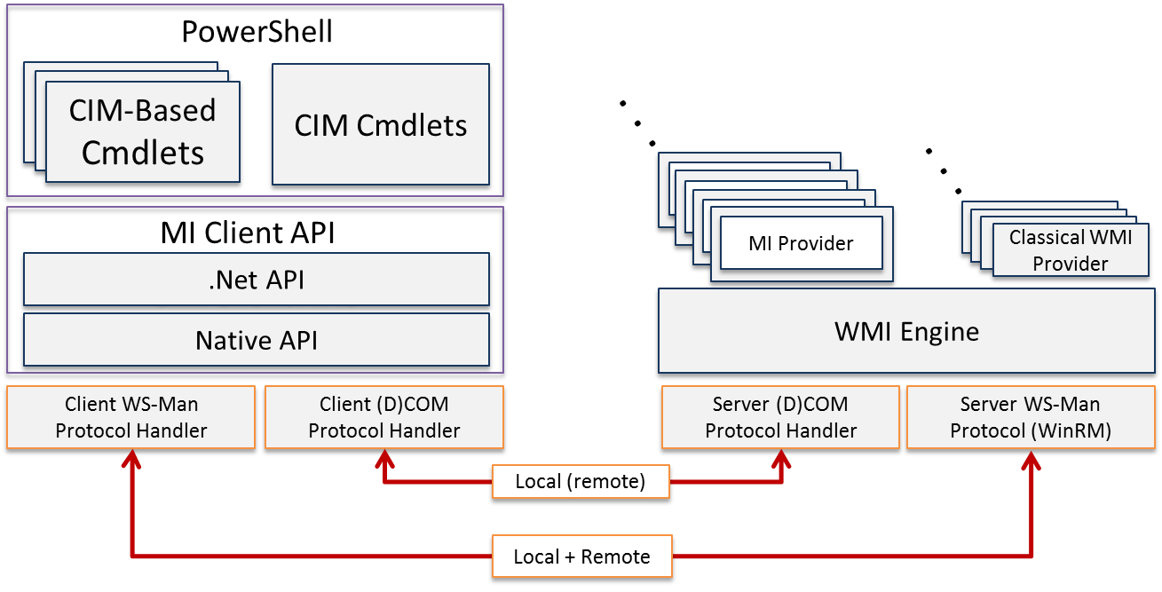

Slide 8
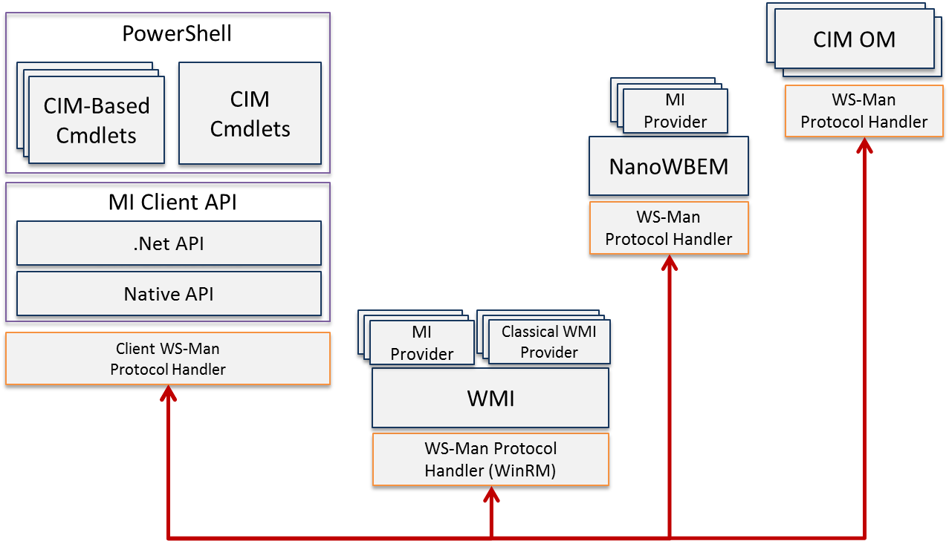
https://blogs.technet.microsoft.com/windowsserver/2012/03/29/standards-based-management-in-windows-server-8/

Slide 9
WMI accelerators
[wmiclass] – create instance
[wmisearcher] – find instance
[wmi] – get specific instance

Slide 10
CIM cmdlets

Slide 11
CIM cmdlets
Get-CimInstance
Invoke-CimMethod
New-CimInstance
Set-CimInstance
Remove-CimSession

Slide 12
WQL

Slide 13
WQL = WMI Query language
Subset of SQL
https://msdn.microsoft.com/en-us/library/aa394606(v=vs.85).aspx
SELECT only
No joins
Operators
https://msdn.microsoft.com/en-us/library/aa394605(v=vs.85).aspx
Wildcards
% = *
_ = .

Slide 14
CDXML and CIMservice module

Slide 15
CDXML
60% of cmdlets in Windows 8/2012 and later
CIM class
Wrap in XML
Publish as module
‘Free parameters’
[-CimSession <CimSession[]>] [-ThrottleLimit <int>] [-AsJob] [<CommonParameters>]

Slide 16
CDXML
Behaviours dependent on provider
WhatIf
Confirm
Verbose doesn’t do anything
Most of advanced function parameter validation available
NOT ValidateScript
NOT ValidatePattern

Slide 17
CDXML – cmdlets over objects
<?xml version="1.0" encoding="utf-8"?>
<PowerShellMetadata xmlns="http://schemas.microsoft.com/cmdlets-over-objects/2009/11">
<Class ClassName="root\cimv2/Win32_Service">
<Version>1.0</Version>
<DefaultNoun>CIMService</DefaultNoun>
<InstanceCmdlets>
<GetCmdletParameters DefaultCmdletParameterSet="ByName">
<QueryableProperties>
<Property PropertyName="State">
<Type PSType ="String"/>
<RegularQuery AllowGlobbing="true">
<CmdletParameterMetadata PSName="State" ValueFromPipelineByPropertyName="true" CmdletParameterSets="ByName" />
</RegularQuery>
</Property>
</QueryableProperties>
</GetCmdletParameters>
</InstanceCmdlets>
</Class>
</PowerShellMetadata>

Slide 18
CDXML: Parameter sets Current Syntax
Get-CIMService [-Name <string[]>] [-DisplayName <string[]>] [-State <string[]>] [-StartMode <string[]>] [-Started <bool[]>] [-DelayedAutoStart <bool[]>] [-AcceptPause <bool[]>]
[-AcceptStop <bool[]>] [-DesktopInteract <bool[]>]
[-ServiceType <string[]>] [-Status <string[]>]
The following you get for ‘free’
[-CimSession <CimSession[]>] [-ThrottleLimit <int>] [-AsJob] [<CommonParameters>]

Slide 19
CDXML: Parameter sets Target Syntax
Get-CIMService [-Name <string[]>] [-StartMode <string[]>] [-Started <bool[]>] [-DelayedAutoStart <bool[]>] [-AcceptPause <bool[]>] [-AcceptStop <bool[]>] [-DesktopInteract <bool[]>] [-ServiceType <string[]>] [-Status <string[]>] [-CimSession <CimSession[]>] [-ThrottleLimit <int>] [-AsJob] [<CommonParameters>]
Get-CIMService [-DisplayName <string[]>] [-StartMode <string[]>] [-Started <bool[]>] [-DelayedAutoStart <bool[]>] [-AcceptPause <bool[]>] [-AcceptStop <bool[]>] [-DesktopInteract <bool[]>] [-ServiceType <string[]>] [-Status <string[]>] [-CimSession <CimSession[]>] [-ThrottleLimit <int>] [-AsJob] [<CommonParameters>]
Get-CIMService [-State <string[]>] [-StartMode <string[]>] [-Started <bool[]>] [-DelayedAutoStart <bool[]>] [-AcceptPause <bool[]>] [-AcceptStop <bool[]>] [-DesktopInteract <bool[]>] [-ServiceType <string[]>] [-Status <string[]>] [-CimSession <CimSession[]>] [-ThrottleLimit <int>] [-AsJob] [<CommonParameters>]

Slide 20
Issues and Gotchas

Slide 21
Issues and Gotchas
Dates
Integer code values
CIM cmdlets = inert objects
Invoke-WmiMethod arguments for method
Amended data
DCOM authentication required e.g. Accessing IIS

Slide 22
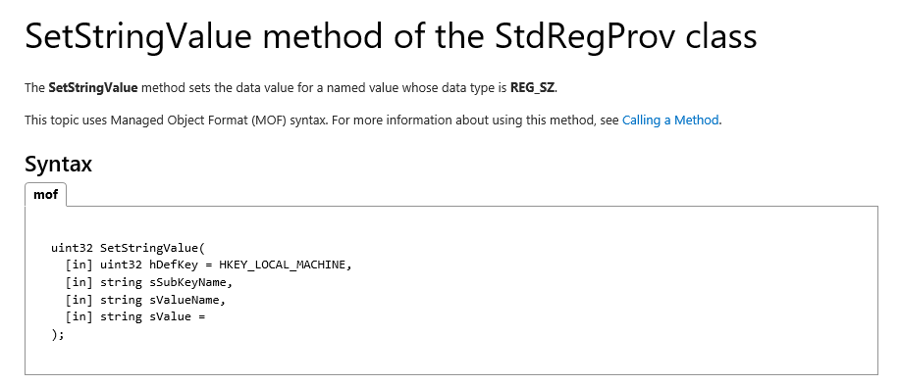
WMI Method parameter issue: Documentation shows this

Slide 23
CIM events

Slide 24
Events
Indications with CIM cmdlets
Register-CimIndication
Uses PowerShell event engine
Use of –Action triggers a JOB

